Slide 1

Critical Turtle

Slide 2

Critical Turtle
Scale from 0 out of 10
“Would you take it home as pet?”
0 - Definitely not
10 - I would love to!

Slide 3
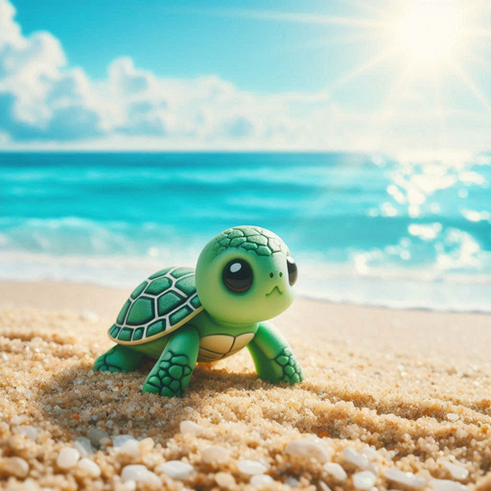

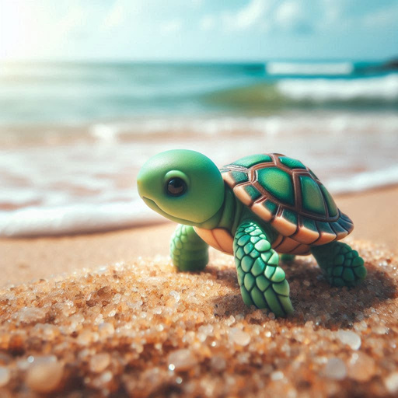
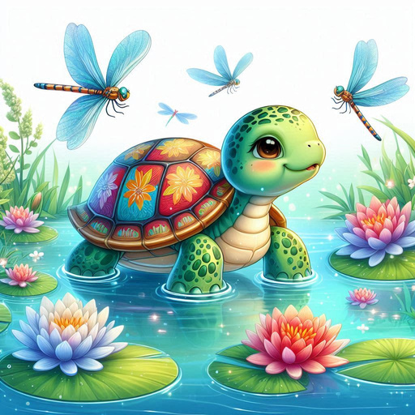
Critical Turtle

Slide 4
Critical Turtle
9 out of 10
7.5 out of 10
8.5 out of 10
8 out of 10

Slide 5



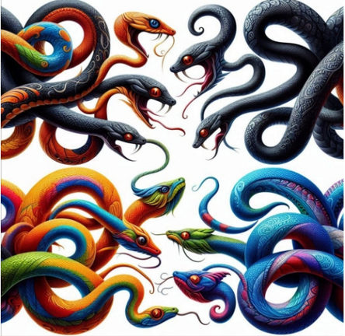
Critical Turtle

Slide 6
Critical Turtle
2.5 out of 10
6 out of 10
5.5 out of 10
3.5 out of 10

